Slide 1
Children’s Funding Project
“What gets budgeted, gets done”
© Children’s Funding Project, 2024
Notes:
Children’s Funding Project is a nonprofit social impact organization that helps communities and states expand equitable opportunities for children and youth through strategic public financing. childrensfundingproject.org. We focus on financing because what gets budgeted gets done.

Slide 2
About Us
Children’s Funding Project is a nonprofit social impact organization that helps communities, states, and Native nations expand equitable opportunities for children and youth through strategic public financing.
We collaborate with local leaders and advocates to help them understand the multiple sources of funding for children and youth, identify sustainable ways to fund their goals for kids, and develop customized financing solutions tailored to their needs. Our library of resources, custom tools, one-on-one coaching, and training events help advocates, policymakers, and Native leaders develop the skills they need and build collective momentum toward an equitable future for all children.
childrensfundingproject.org
Top photo by Allison Shelley for EDUimages

Slide 3
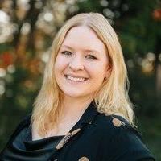
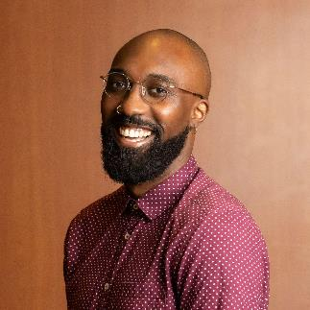
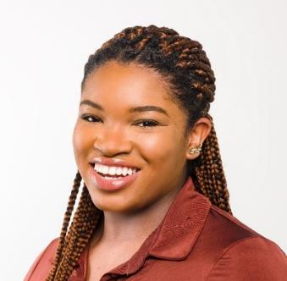
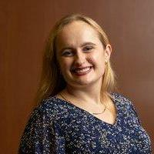
Our Coaching Team
Sarah Eicher
Cost Modeling Coach
Kenny Francis
Director
Coaching and Capacity
Building
Danyelle Norment
Fiscal Mapping Coach
Kylie Wheeler
Manager
Products and Capacity Building
Children’s Funding Project is a nonprofit social impact organization that helps communities and states expand equitable opportunities for children and youth through strategic finance planning. childrensfundingproject.org
© Children’s Funding Project, 2024

Slide 4
What Is a Children’s Funding Coordinator?
A person whose job it is to wake up every morning thinking about how to increase funding, resources, and access for children in their community through strategic public finance planning.
Key Responsibilities
Become an expert on Children’s Funding Project’s field-tested methodologies for strategic public finance planning
Facilitate collaboration between community partners and local budget holders
Deliver localized fiscal mapping, cost modeling, and sourcing additional funding analyses
Train others in the community to expand capacity and grow local strategic public financing expertise
B
© Children’s Funding Project, 2024
Photo by Allison Shelley/The Verbatim Agency for EDUimages
Notes:
Expanding our Impact: Building capacity through SPF Coordinators
New, innovative position
Strategic public financing is a process that allows states and communities to assign a cost to their goals and policy priorities for children and youth and, ultimately, to identify ways to cover those costs. It often builds on existing strategic plans by addressing the following three questions:
1. Current investment: How much funding supports our goals right now?
2. True cost: How much will it cost to fully fund our goals?
3.New funding: How do we fill the gap between current funding and needed funding?
State and community leaders then can use fiscal maps, cost models, and revenue generation research and analysis as tools to answer these questions.
Children’s Funding Project supports strategic public financing efforts through coaching and technical assistance, always with the goal of helping state and community leaders build their own lasting local expertise. This is why we encourage and are available to provide a broad range of supports to every state and community interested in hiring its own strategic public financing coordinator who can lead the way to long-term, sustainable funding for children and youth.

Slide 5
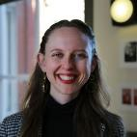
Children’s Funding Coordinators in Action
Pooja Gupta Sheth
Cleveland, OH
Starting Point
We have a growing network of children’s funding coordinators who are building the skills needed to fund actionable solutions for kids in their communities.
Annette Dangerfield
Louisville, KY
Louisville Metro Government
Current Funding Focus
Britt Anuszkiewicz
Montgomery County, MD
Children’s Opportunity Alliance
Early Childhood
Out-of-School Time
Margo Kinneberg
Austin, TX
United Way of Greater Austin

Slide 6
WE WANT TO WORK WITH…
BY PROVIDING…
TO BUILD…
People with lived experience with children’s issues who have an interest in policy, system building, and advocacy
1. Hiring support that includes equitable hiring training
2. Skill-building around project management, writing for public policy, data analysis, and visualization
A robust network of lived experience policy leaders with strategic public finance planning expertise
and
3. Coaching and training resources for all elements of strategic public finance planning
Hiring partners and funders committed to empowering lived experience leaders
4. Support for ongoing capacity building and planning

Slide 7
What Is “Strategic Public Finance Planning?”
Fiscal mapping
Current Investment
How much money are we currently investing in our strategic priorities for children and youth?
A strategic public financing plan picks up where strategic plans often leave off.
It identifies
Cost to Implement
What will it cost to fund new or underfunded priorities? What will it cost to scale currently funded priorities?
Cost estimation and modeling
New Funding Sources
What revenue streams can we use to pay for identified costs?
Sourcing Additional Funding
Children’s Funding Project is a nonprofit social impact organization that helps communities, states, and Native nations expand equitable opportunities for children and youth through strategic public financing. childrensfundingproject.org
© Children’s Funding Project, 2024

Slide 8
What Is a “Fiscal Map?”
An analysis of the funding streams that finance child and youth services
Can include public (federal, state, local) and private (philanthropy) dollars
A fiscal map answers the question WHO invests HOW MUCH and in WHAT?
Photo by Allison Shelley/The Verbatim Agency for EDUimages

Slide 9
Fiscal Mapping Timeline
Lessons 1-6
Lesson 7
Lesson 8
Lesson 9
Lessons 10-12
Overview of fiscal mapping, prioritizing equity, defining your goal, scope and parameters
Requesting information from and interviewing budget holders
Cleaning and validating data, managing outliers, and uniformly coding data
Analyzing and visualizing fiscal mapping data and building an interactive fiscal mapping tool in Power BI
How and when to update your fiscal map and building relationships for sustainability
Fiscal Mapping Kick-Off
2 months
Collecting Data
4 months
Cleaning and Coding Data
1 month
Building Your Fiscal Mapping Tool
2 months
Maintaining and Sustaining Closeout
3 months
5
1
3
2
4
Children’s Funding Project is a nonprofit social impact organization that helps communities, states, and Native nations expand equitable opportunities for children and youth through strategic public financing. childrensfundingproject.org
© Children’s Funding Project, 2024
9

Slide 10
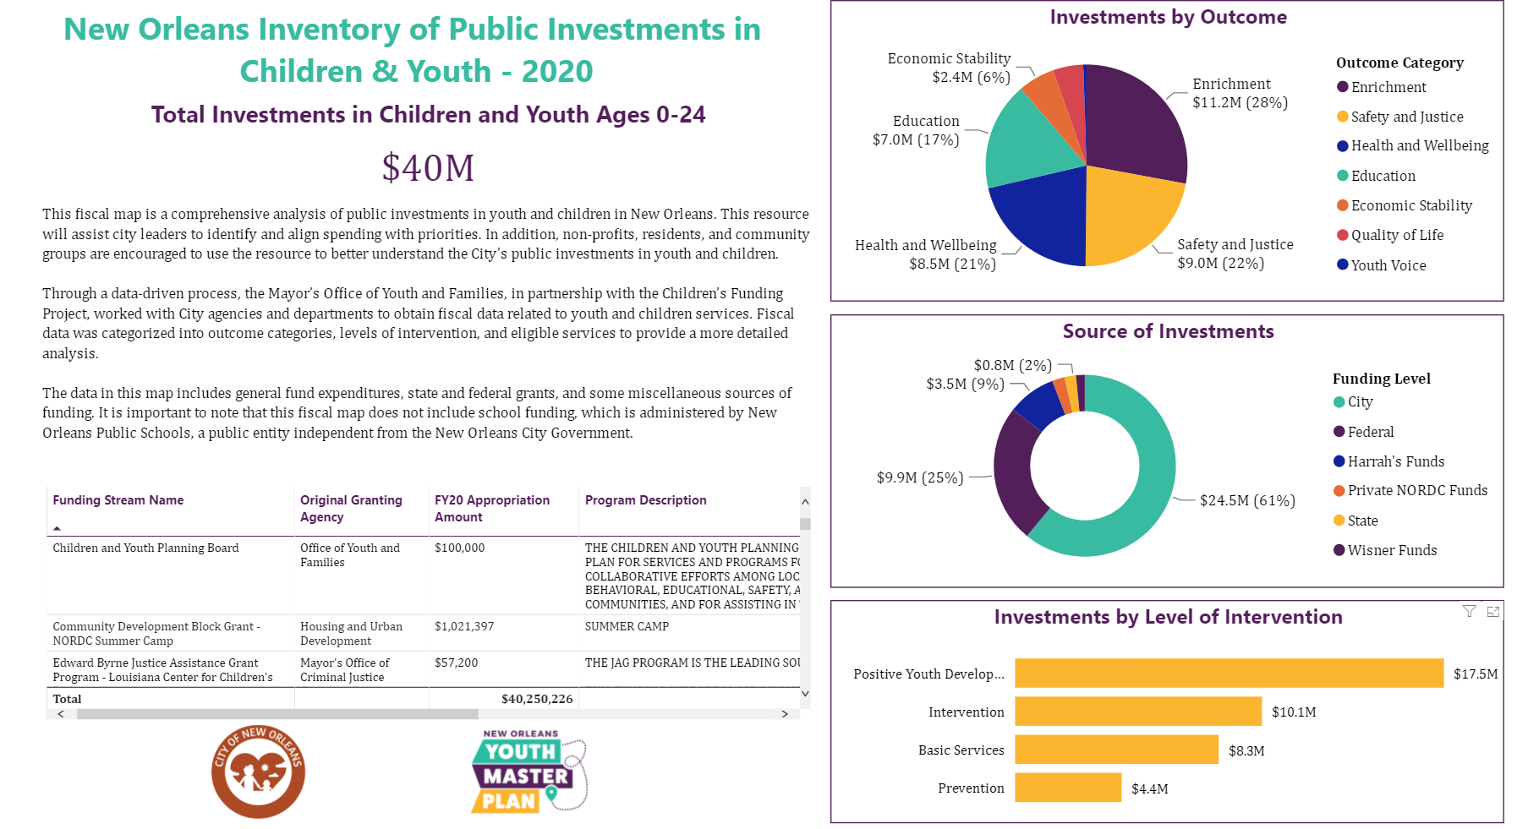
New Orleans Data Book and Fiscal Map
Link here. Click on “What are we spending?”
Children’s Funding Project is a nonprofit social impact organization that helps communities, states, and Native nations expand equitable opportunities for children and youth through strategic public financing. childrensfundingproject.org
© Children’s Funding Project, 2024

Slide 11
What Is a Cost Model?
A cost model is an approach to measuring the true cost of implementing and maintaining a service or program.
1
2
3
4
Aims to Understand
Useful for
Structural Cost Drivers
Operational Cost Drivers
Costs of providing a service or program (per child, per classroom, or total)
How changes in quality variables impact overall costs
How geography or program size impacts overall costs
Determining true cost of care against market cost
Setting appropriate rates
Improving staff wages and benefits
Making a case for more funding
Programmatic requirements an/or licensing standards
Ratios/group size or caseload
Geography
Minimum wage requirements
Wages and benefits
Rent/utilities
Food, supplies, transportation, and other nonpersonnel costs
Professional development
Quality add-on components
Children’s Funding Project is a nonprofit social impact organization that helps communities, states, and Native nations expand equitable opportunities for children and youth through strategic public financing. childrensfundingproject.org
© Children’s Funding Project, 2024

Slide 12
Cost Modeling Timeline
Lessons 1-6
Lesson 7
Lesson 8
Lesson 9
Lesson 10
Overview of cost modeling, prioritizing equity, finalizing goals, and determining parameters
Understanding the data collection process, designing and reviewing your survey, and handling missing data
Creating your data workbook, raw data cleaning, and aggregating data for summary statistics
Formatting your cost model, building your Excel formulas, analyzing your cost model data, and creating a memo
How and when to update your cost model, building relationships for sustainability, and reflection
Cost Modeling
Kick-off
1 month
Identifying and Collecting Data
3 months
Cleaning and Aggregating
Your Data
1 month
Building Your Cost Model and Analysis Memo
1 month
Maintaining and Sustaining Closeout
1 month
5
1
3
2
4
Children’s Funding Project is a nonprofit social impact organization that helps communities, states, and Native nations expand equitable opportunities for children and youth through strategic public financing. childrensfundingproject.org
© Children’s Funding Project, 2024
12

Slide 13
Tangible Benefits of Cost Modeling
Cost models are used to achieve a variety of goals, by allowing people to understand the impact of different program options and policy choices, backed by real data.
To help state and local leaders compare actual cost of administering a program with the market cost
To cost out a grant, contract, program, service or initiative
To set a daily rate for subsidy programs
To cost out the impact of a policy change
To cost out a desired system and/or fiscal planning
To advocate for increased investment in programs and services for children and families
Some of the most common reasons people invest in cost models
Children’s Funding Project is a nonprofit social impact organization that helps communities, states, and Native nations expand equitable opportunities for children and youth through strategic public financing. childrensfundingproject.org
© Children’s Funding Project, 2024

Slide 14
Revenue and Funding Options Research
Filling the gaps in funding for children and youth will require thinking beyond your current sources of funding.
What are your typical sources of funding?
What other sources of funding should you consider?
Federal grants
State budget allocations
City or county budget allocations
Dedicated public funding stream
Community Benefits Agreements
Tax credits (individual or business)
National foundations
Local foundations
Local United Way
Pay for Success
Medicaid reimbursements
Community Reinvestment Act agreements
Corporate giving
Individual donors
Fee-based services
Profits from publicly held assets
In-kind facilities usage
Fee-based services
READ: Innovative Financing to Expand Services So Children Can Thrive
Children’s Funding Project is a nonprofit social impact organization that helps communities and states expand equitable opportunities for children and youth through strategic finance planning. childrensfundingproject.org
© Children’s Funding Project, 2024

Slide 15
Sourcing Additional Funding Timeline
Lessons 1-2
Lessons 3-4
Lesson 5
Lesson 6
Lesson 7
Overview of sourcing additional funding and initial assessment
Researching and gathering foundational information about local funding options
Power mapping. Identifying critical partners and key community members needed to pursue funding options
Feasibility assessment. Determining likelihood of implementation and success of funding options
Plan development and implementation. Designing and implementing a strategy for funding options
Sourcing Additional Funding Kick-Off
1 month
Research
2 months
Power mapping
2 weeks
Feasibility Assessment
2-3 months
Plan Development and Implementation
TBD
5
1
3
2
4
Children’s Funding Project is a nonprofit social impact organization that helps communities and states expand equitable opportunities for children and youth through strategic finance planning. childrensfundingproject.org
© Children’s Funding Project, 2024
15

Slide 16
In this phase of the process, children’s funding coordinators learn how to
Revenue and Funding Options Research
Navigate the results of revenue and funding options research
Ask the right questions of the right people, including subject-matter experts and community partners, to determine the most promising new funding options
Communicate the results of funding options research to different audiences in the community with the goal of achieving consensus on funding options to pursue
16
Children’s Funding Project is a nonprofit social impact organization that helps communities and states expand equitable opportunities for children and youth through strategic finance planning. childrensfundingproject.org
© Children’s Funding Project, 2024
16

Slide 17
A-to-Z Checklist for a Successful Effort
Start with a Strong Foundation
Chart Your Course
Build and Engage Your Coalition
Create a steering committee
Determine the fund’s purpose and intended impact
Study models of success
Research potential public funding mechanisms
Identify viable pathways to the ballot
Conduct polling to inform decision-making
Select an election date and create a timeline
Experience collaborating for kids
Community-wide goals for kids
Defined funding needs
A motivated coalition
A convening entity
H. Conduct outreach and build your lists
I. Create opportunities for multiple types of engagement and make the ask
J. Transition your coalition into campaign roles
Craft Your Ordinance and Question
Communicate with the Public and Engage Voters
Build a Strong Campaign Infrastructure
K. Plan your fund’s infrastructure for administration and oversight
L. Craft a draft
M. Get coalition feedback
N. Engage a lawyer and negotiate with elected officials and public offices
O. Submit for ballot placement
*transition to campaign mode*
V. Use polling and a communications firm to develop your communications plan
W. Train your coalition on message discipline
X. Set a date to launch your campaign
Y. Mobilize volunteers
Z. Engage voters and GOTV!
P. Recruit a campaign committee
Q. Create a campaign budget
R. Select a treasurer and open a bank account
S. Legally establish the campaign
T. Hire a campaign manager and develop a campaign plan
U. Focus on fundraising
Children’s Funding Project is a nonprofit social impact organization that helps communities, states, and Native nations expand equitable opportunities for children and youth through strategic public financing. childrensfundingproject.org
© Children’s Funding Project, 2024

Slide 18
First Steps Kent Millage
Kent County, Michigan
The ongoing goals of the Ready by Five Early Childhood Millage are to
Annual revenue
$5.7 million Year established
2018 Type of revenue
Property tax Levy amount
$0.25 per $1,000 of assessed property value What it funds
Early childhood
Administrating infrastructure
First Steps Kent
Increase early learning opportunities and child health by increasing access to quality programming for expecting mothers and children ages 0-5 in Kent County |  | Increase cross-sector collaboration between providers to ensure families are being connected with needed services in the form of a warm handoff through referrals and data sharing |  | Reduce outcome disparities across specific target populations by ensuring culturally relevant and inclusive services and supporting programs that serve traditionally underserved community members
HOW?
By investing in programs that contribute to four indicators of kindergarten success:
Parents will have increased access to resources and information
Mother’s health and wellbeing
Children are developmentally on track
Children are healthy
Community-based organizations apply for funding to provide services such as home visiting, play and learn groups, developmental screening, and navigation support to help families access the help they need and want.
Children’s Funding Project is a nonprofit social impact organization that helps communities, states, and Native nations expand equitable opportunities for children and youth through strategic public financing. childrensfundingproject.org
© Children’s Funding Project, 2024

Slide 19
Colorado Children’s Campaign – November 2020
PROPOSITION EE: An incremental tax increase on cigarettes and tobacco products, and a new tax on liquid nicotine (vaping).
Revenue:
$176M in total revenue 2020-21, increasing to $275M in 2027-28
Revenue will initially go to k-12 public schools, affordable housing, and tobacco education, prevention, and cessation, but starting in 2024 will be used to fund pre-k - $168M in first year, growing to $242M when fully implemented
Key messages:
Save lives by reducing tobacco and vape use through higher product prices and funding tobacco prevention and cessation programs.
Shield K-12 schools from deep budget cuts caused by COVID and provide universal, free preschool in fall of 2023.
Proposition EE won with 67.56% of the vote
Children’s Funding Project is a nonprofit social impact organization that helps communities, states, and Native nations expand equitable opportunities for children and youth through strategic public financing. childrensfundingproject.org
© Children’s Funding Project, 2024

Slide 20
Pre-hire:
Equitable hiring training*
Onboarding:
Pre-coaching skills assessment
Skill building trainings: Microsoft Excel, PowerBI, Writing for Public Policy
Strategic Public Finance Planning Skills Coaching
Fiscal Mapping
Cost Modeling
Revenue and Funding Options Research
Community Capacity Building
Ongoing professional development:
Project management certification
Data analytics certification
Effective communication: Writing, Design & Presentation
Storytelling and influencing
Public speaking
Children’s Funding Coordinator Syllabus Overview
*For hiring partner organization
Children’s Funding Project is a nonprofit social impact organization that helps communities, states, and Native nations expand equitable opportunities for children and youth through strategic public financing. childrensfundingproject.org
© Children’s Funding Project, 2024
20

Slide 21
Journey of a Children’s Funding Coordinator: Our Role
Assessing skill building needs;
Providing professional development on skills needed for role
Support development and execution of community capacity building plan
Coaching
Hiring
Provide training in strategic public financing methodologies;
Supporting development of work products and memos;
Provide ongoing coaching, support and professional development opportunities
Assessing readiness; Providing training on hiring practices; Supporting interview process
Onboarding
Community Capacity Building
3 months
1 month
11 months
3 months
Full life cycle is ~ 18 months
Children’s Funding Project is a nonprofit social impact organization that helps communities, states, and Native nations expand equitable opportunities for children and youth through strategic public financing. childrensfundingproject.org
© Children’s Funding Project, 2024

Slide 22
Journey of a Children’s Funding Coordinator: Hiring Org Role
Support children’s funding coordinator in building relationships essential to the role
Support children’s funding coordinator in identifying community partners to train;
Support delivery of training
Coaching
Hiring
Provide guidance on goals and timelines;
Support children’s funding coordinator with partner outreach related to strategic public financing work products
Lead community outreach about children’s funding coordinator role;
Lead interview process;
Make hire
Onboarding
Community Capacity Building
3 months
1 month
11 months
In perpetuity
Children’s Funding Project is a nonprofit social impact organization that helps communities, states, and Native nations expand equitable opportunities for children and youth through strategic public financing. childrensfundingproject.org
© Children’s Funding Project, 2024

Slide 23
Journey of a Children’s Funding Coordinator: Coordinator’s Role
Using and updating strategic public financing work products;
Developing and executing a community capacity building plan; Serving as local child and youth funding expert (ex: leader of children’s cabinet, primary implementer of a voter approved children’s fund, etc.)
Skill building,
Shadowing, Building relationships
Coaching
Learning strategic public financing methodologies and how to create work products;
Leading development of work products; Participate in ongoing professional development offerings
Onboarding
Community Capacity Building
1 month
11 months
In perpetuity
Children’s Funding Project is a nonprofit social impact organization that helps communities, states, and Native nations expand equitable opportunities for children and youth through strategic public financing. childrensfundingproject.org
© Children’s Funding Project, 2024

Slide 24
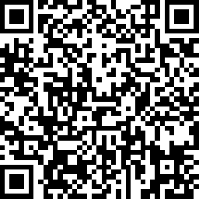
Thanks!
If you are interested in establishing a children’s funding coordinator position in your community, fill out this application .
Questions? Contact kenny@childrensfundingproject.org
Children’s Funding Project is a nonprofit social impact organization that helps communities and states expand equitable opportunities for children and youth through strategic public financing. childrensfundingproject.org
© Children’s Funding Project, 2024
Photo by Allison Shelley for EDUimages

