Slide 1
Public Funding for Children and Youth
Data and Initial Findings from 14 State Cradle-to-Career Fiscal Maps
November 16, 2023, 2:00pm ET
Photo by Allison Shelley/The Verbatim Agency for EDUimages

Slide 2
Webinar Agenda
1
State Child and Youth Fiscal Map Cohort Overview
2
Walk through of a state fiscal map
3
Hear from cohort participants
4
National trends in state funding
5
Opportunities for states
6
Sustaining the database

Slide 3
Origin Story
25 years ago, Elizabeth ran Safe Haven, a high-quality after-school program for children living in subsidized housing.
Needed more stable resources so moved on to state-level youth advocacy, trying to secure tobacco settlement dollars.
“It was like a revolving door of federal, city, private funding and we couldn’t meet the demand for the program”
Elizabeth put together a detailed state fiscal map (one of the first in the country) and made the case for more funding.
“Legislators asked, ‘Well, how much do we spend on youth development in the state now?’”
Elizabeth headed to DC to work at the Forum for Youth Investment on fiscal mapping, children’s cabinets, etc.
But a state budget crisis hit, and the youth development dollars got cut. Frustrated, Elizabeth did a stint in a presidential campaign.
Elizabeth and Olivia transition Children’s Funding Project out of the Forum to laser focus on the money.
“How do we turn fiscal maps and youth development plans into sustained public investments?”
The seed was planted: “We weren’t using enough campaign savvy in the youth field”
“How do we build enough capacity for every community in the country to fully fund their strategic plans for kids?”
Children’s Funding Project is a nonprofit social impact organization that helps communities and states expand equitable opportunities for children and youth through strategic public financing. childrensfundingproject.org
© Children’s Funding Project, 2023

Slide 4
VISION
We envision a nation where all children and youth thrive because all communities maintain equitable, coordinated, and sustainable funding for comprehensive programs and services.
MISSION
Children’s Funding Project helps communities and states expand equitable opportunities for children and youth through strategic public financing.
Children’s Funding Project is a nonprofit social impact organization that helps communities and states expand equitable opportunities for children and youth through strategic public financing. childrensfundingproject.org
© Children’s Funding Project, 2023
Photo by Allison Shelley for EDUimages

Slide 5
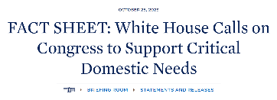
Why do we need to document public investments in kids NOW?

Slide 6
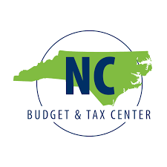
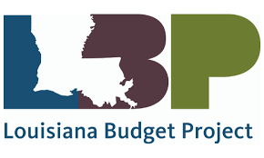
State Child and Youth Fiscal Map Cohort

Slide 7
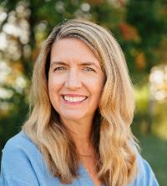
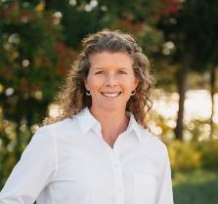
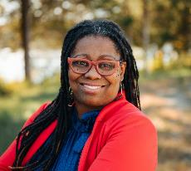
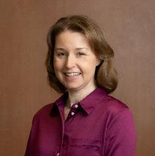
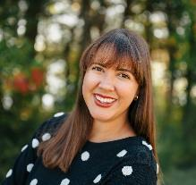
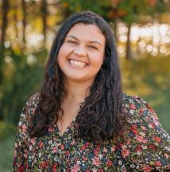
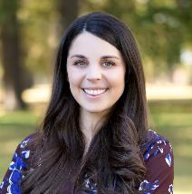
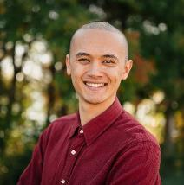
Children’s Funding Project Team
Elizabeth Gaines
Amelia Vaughn
Alicia Wilson Ahlstrom
Tom Devaney
Kristen Loschert
Chief Executive Officer
Co-Director of Research Capacity
Co-Director of Research Capacity
Chief Administrative Officer
Communications Director
Laura Lopez
Alea Simons
Ashley Brooks
Allie Farrell
Shane Linden
Fiscal Mapping Project Manager
Senior Policy Associate
Research Associate
Communications & Partnerships Manager
Communications Associate II

Slide 8
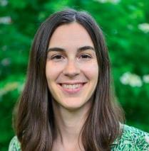
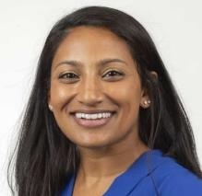
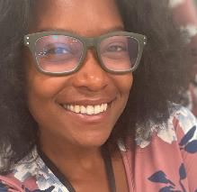
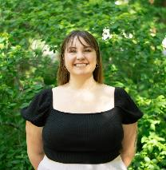
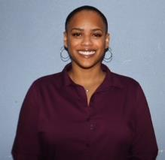
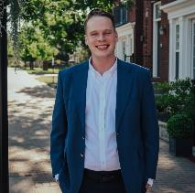
Community Innovation and Action Center Project Team
Kiley Bednar
Paul Sorenson
Sapna Varkey
Peace Bowles
Co-Director
Co-Director
Evaluation Lead
Graduate Research Assistant
Nat Mudd Brooks
Wyatt Humrichous
Ari Morris
Lacey Corbett
Data Analyst
Data and Research Associate
Graduate Assistant
Community Data & Research Associate

Slide 9
Poll
Who is in the audience?
What is your ‘why’ for being here today?
Photo by Allison Shelley for EDUimages

Slide 10
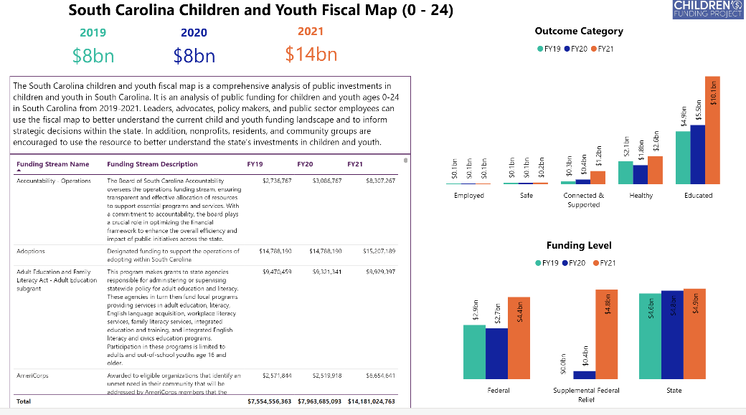
Walkthrough of a state fiscal map

Slide 12
CFP/NCFF Partnership Experience
Children's Funding Project staff were accessible, flexible, and great thought partners.
Balanced individual needs with cohort process
Public Agencies were great partners
How can we make this process easier for our state agency partners?
Sustainability of this work?

Slide 13
Using our Fiscal Map
Contextualizing the Numbers
Federal Fiscal Cliff
What does all this mean?
Non-comparison to other states
Policymakers Toolkit
Community Driven Action
How can we encourage communities to use the map to strengthen services for youth and families?

Slide 14
Minnesota Children’s Fiscal Map
Stephanie Hogenson, Children’s Cabinet Policy Director
stephanie.hogenson@state.mn.us

Slide 15
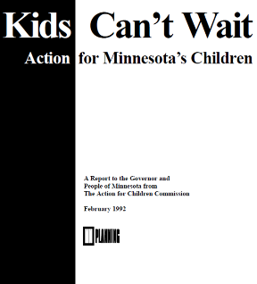
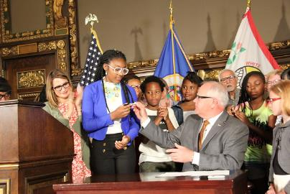
Minnesota’s Children’s Cabinet
Align people, data, money and policy around children
Children’s Cabinet = Shared Governance
Commissioners , Gov/Lt. Gov Co-chairs
Senior Leadership
Advisory Councils
Guiding Principles
Equity for Minnesota’s children
Leadership engagement
State has a responsibility and cross-agency coordination is necessary
Use data to improve outcomes
Strong partnerships make a positive impact

Slide 16
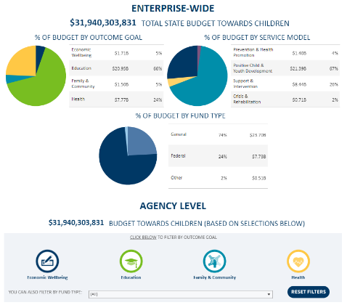
Institutionalizing our fiscal map
Key Steps in the Process
Leadership and Budget Division buy-in and collaboration
Develop instruction manual, Fiscal Map Glossary, and process for tracking decisions on scope
Seek input from fiscal leaders, external partners early
Support from Children’s Funding Project and other states
3) Integrate tagging expenditures in our state’s budget system
4) Update biennially
Simply pull fiscal data on included program and identify any new expenditures in scope
5) Share and provide support to use the map ongoing
Children's Fiscal Map / Minnesota Management and Budget (MMB) (mn.gov)

Slide 17
Increasing and improving children, youth and families funding Examples of fiscal maps uses
Invested more than $16 billion in children and family programs and services last legislative session. To invest best, you have to know what you’re currently spending.
Summary of 2023 Legislative Wins for Minnesota Children and Families
Identified gaps and opportunities to guide governance shift centered on children & families
New Minnesota Department of Children, Youth and Families established July 1, 2024; transition underway
Reviewed map data to inform flexible and new funding related to COVID
Expanded early childhood expenditure analysis for better understanding, coordination
Used the map to identify program areas to convene to better coordinate and support youth prevention, mental wellbeing supports

Slide 18
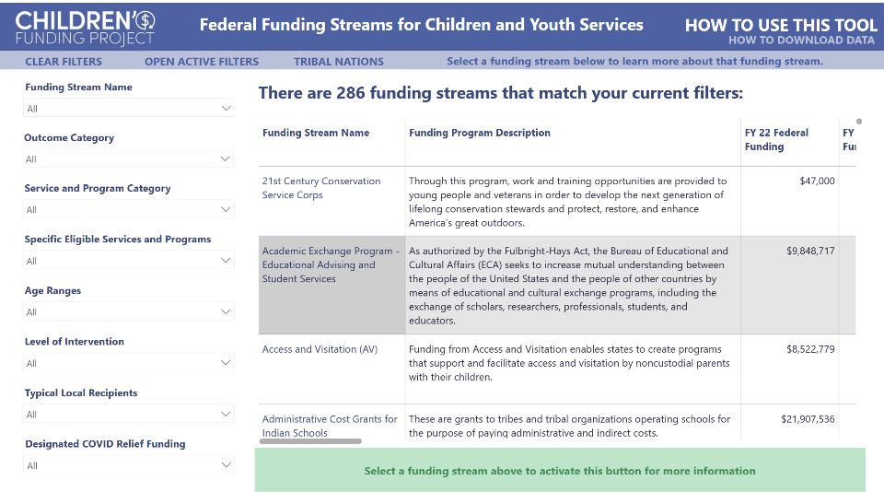
Federal Funding Catalog
Children’s Funding Project is a nonprofit social impact organization that helps communities and states expand equitable opportunities for children and youth through strategic public financing. childrensfundingproject.org
© Children’s Funding Project, 2023

Slide 19
Example: MIECHV Program
Children’s Funding Project is a nonprofit social impact organization that helps communities and states expand equitable opportunities for children and youth through strategic public financing. childrensfundingproject.org
© Children’s Funding Project, 2023

Slide 20
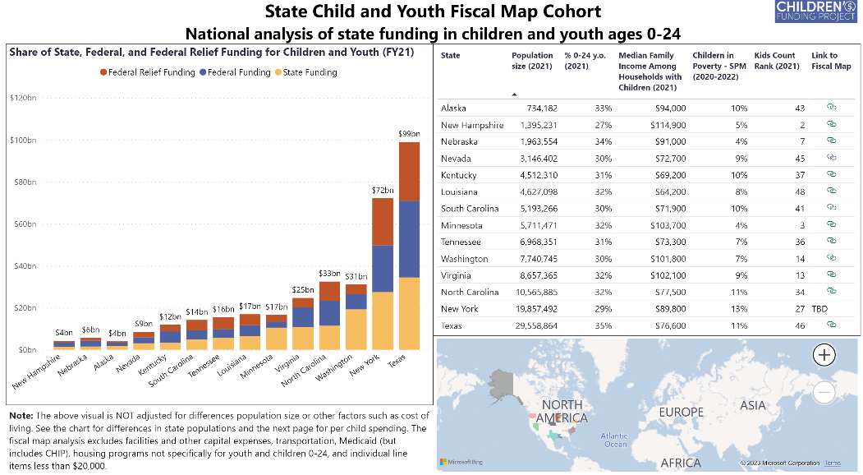
National Trends – Share of Funding Across Levels

Slide 21
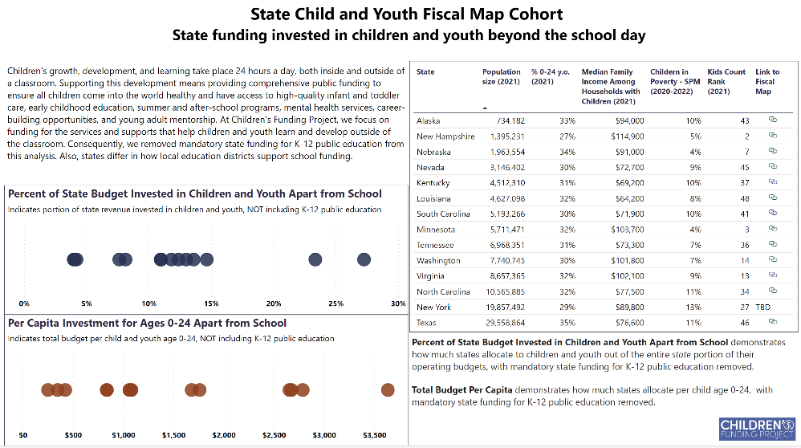
State Funding Beyond the School Day

Slide 22
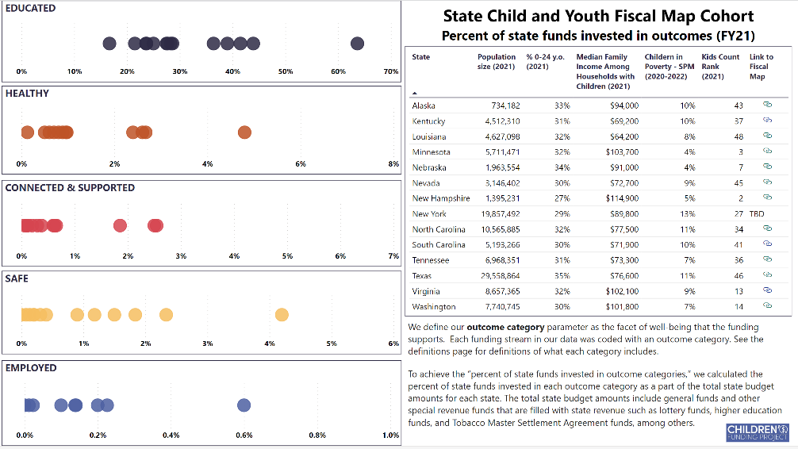
What are states investing in? By “Outcome”

Slide 23
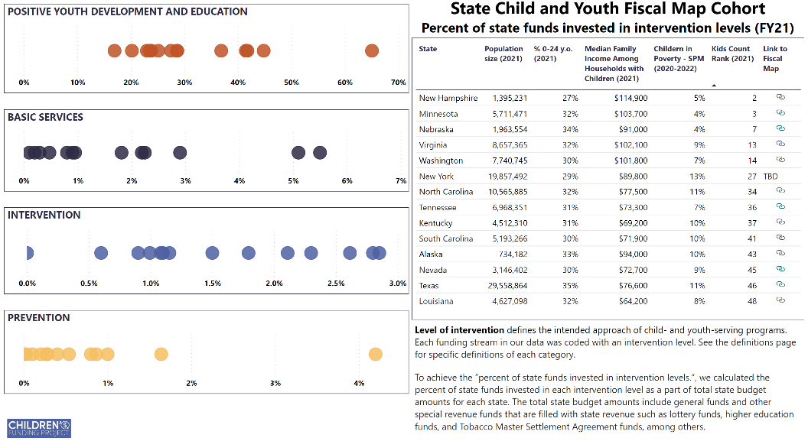
What are states investing in? By “Level of Intervention”

Slide 24
Why this matters
Create a publicly available database of user friendly tools that visualize budget data
“Standardize” how investments for children and youth are talked about across the country
Document funding for children and youth to increase transparency and accountability, especially in the wake of COVID-19 Federal Relief Funding

Slide 25
From Issues → Opportunities

Slide 26
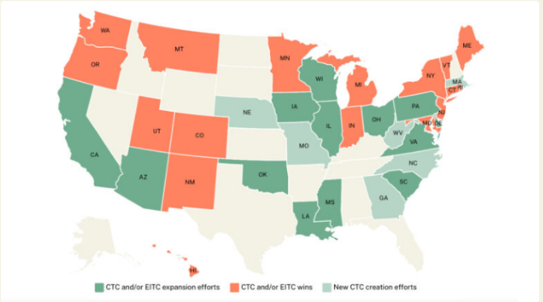
Early state efforts to support children post-COVID
Tax Credits:
An additional $2 billion will be invested in more than 4 million households across 18 states when people file their taxes in 2024 due to expansions passed in 2023 alone.
In 2021, 7 states had a permanent state-level Child Tax Credit; now, 14 states do: CA, CO, ID, ME, MD, MA, MN, NJ, NM, NY, OK, OR, UT, VT.
Data from Economic Security Project
State Dedicated Funding: Minnesota, Vermont and others

Slide 27
Continued Fiscal Map Cohort Engagement
Institutionalize the fiscal mapping process
Support localized maps
Conduct a cost model for specific services
Launch a revenue generation effort
Update new fiscal year data

Slide 28
Cohort Members: Wave 1 and Wave 2

Slide 29
Cohort Members: Wave 1 and Wave 2
If you are interested in learning more about adding your state to the cohort, please fill out this survey!

Slide 30
Questions? Thank you!
Please contact us with feedback Amelia@childrensfundingproject.org

Slide 31
Contact Information
Please contact me at Amelia@childrensfundingproject.org
Get In Touch
2101 L St NW
Suite 800
Washington, D.C., 20037
About Us
Children’s Funding Project is a nonprofit social impact organization that helps communities and states expand equitable opportunities for children and youth through strategic public financing.
(202) 331-4450
childrensfundingproject.org
@FundOurKids
linkedin.com/company/childrens-funding-project/

